Slide 1



Project Mechanical juicer
MENG204 Instructor: Dr. Mamdouh Al-Gendy
Team members:-
1-Ahmed Jamal Harbi 1847432
2-Jayez Al-Rashidy 1847488

Slide 2
AGENDA
1 | Introduction
2 | Functions
3 | Importance
4 | Simulation
5 | Comparison
6 | Drawing sheets
7 | Video

Slide 3
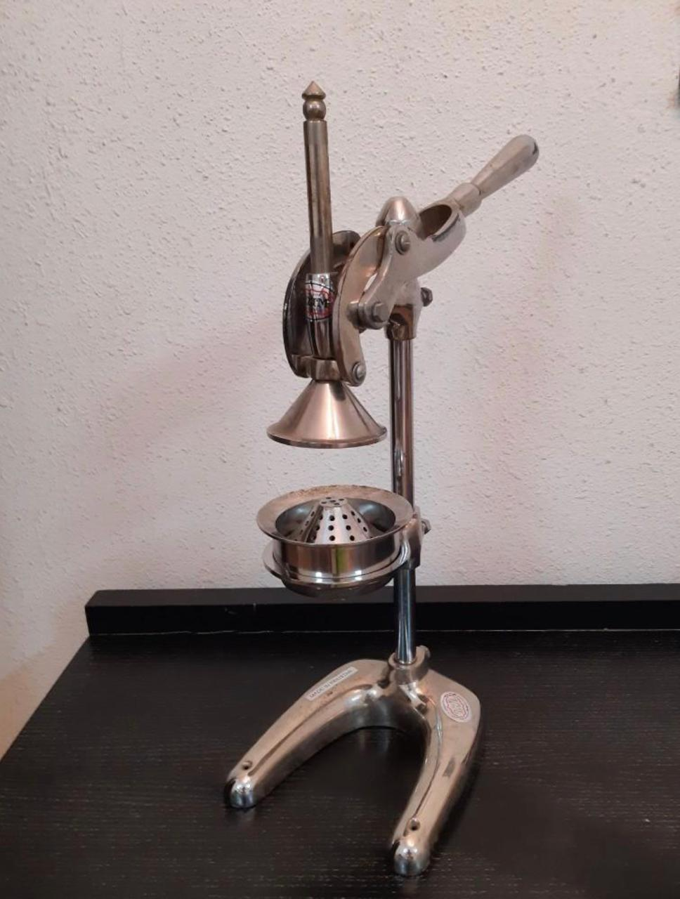
Introduction
Mechanical juicer: is a manual tool made of mechanical parts designed to convert fruits into juice.

Slide 4
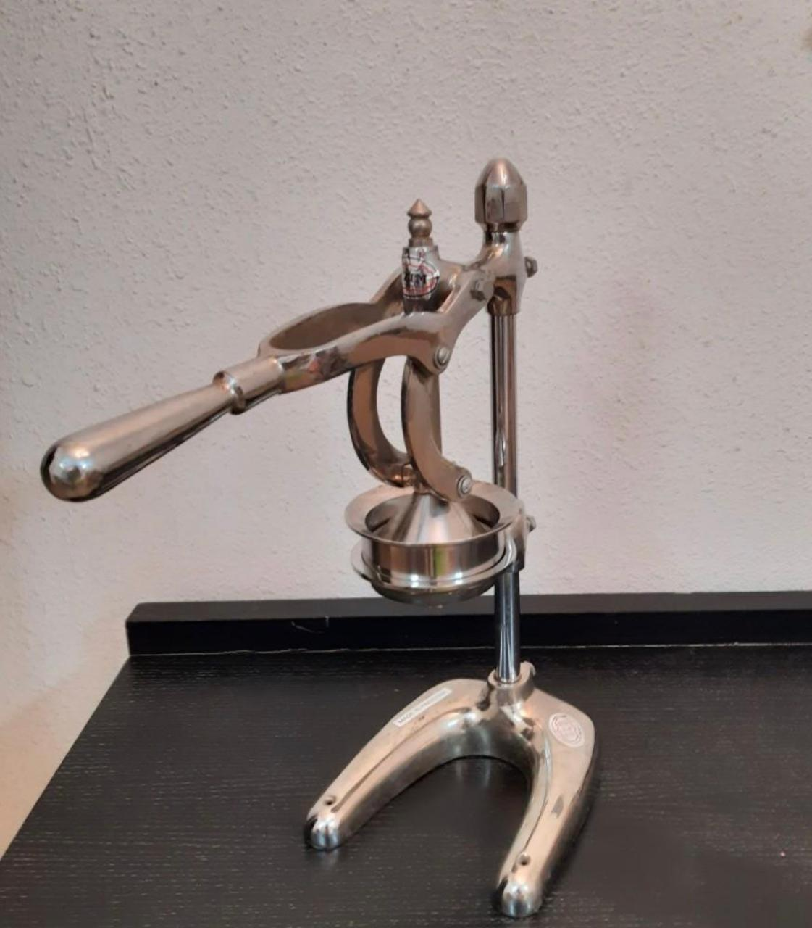
Functions
Its main function is to convert fruits into juice, such as orange, apple, lemon, and others

Slide 5
Importance
Mechanical juicer is found in most homes and juice shops, due to its high quality, ease of use, low price, and most importantly for the user is available at any time and any place.

Slide 6

Simulation

Slide 7
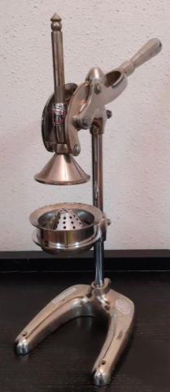
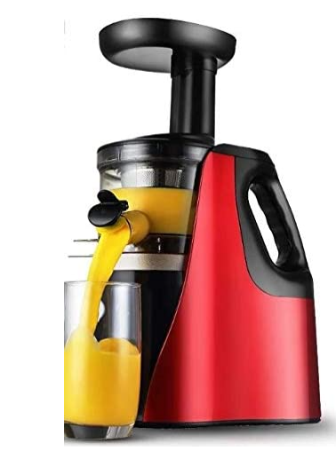
Comparison
Mechanical juicer
Electric juicer
Price | 100SR | 200SR
Weight | 6.67Kg | 6.14Kg
Economic | More | Less
Material | Steel | Steel
Application | Easier | Difficult

Slide 8
Drawing sheets

Slide 9
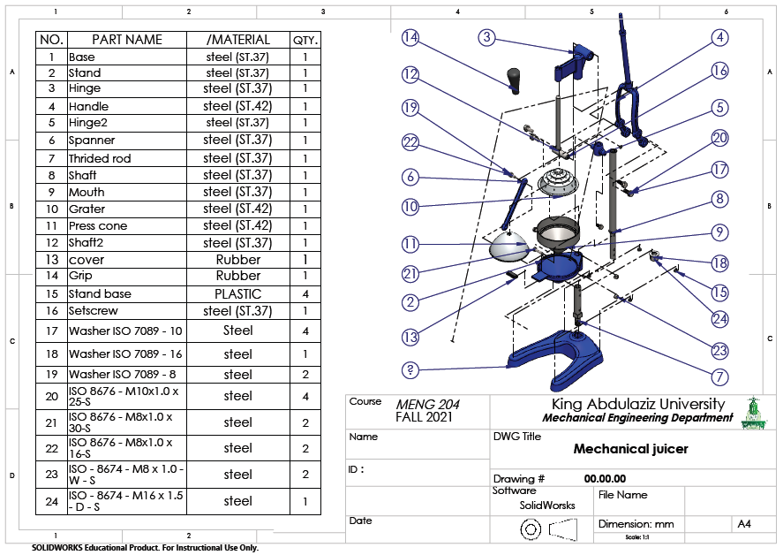

Slide 10
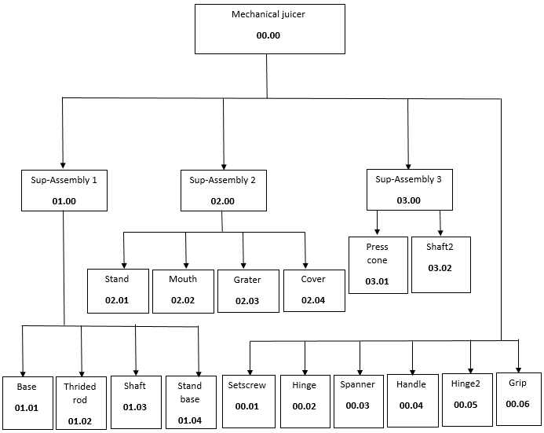

Slide 11
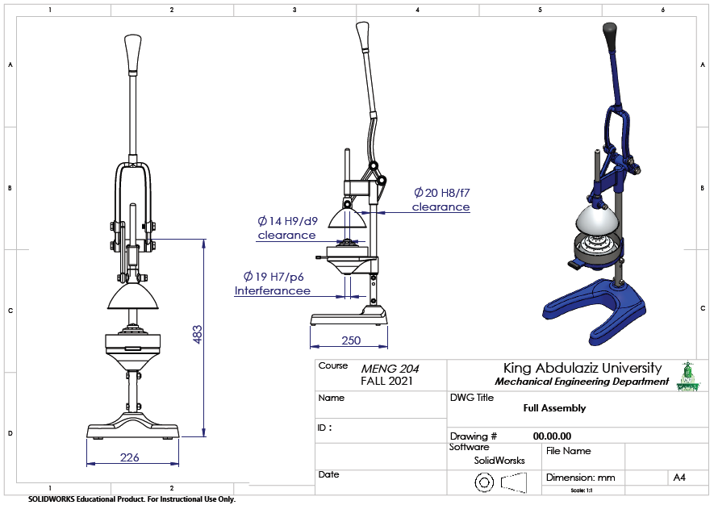

Slide 12
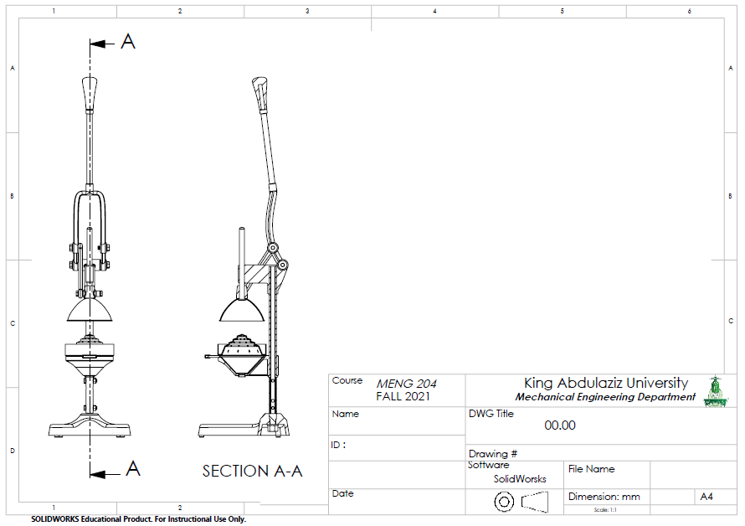

Slide 13
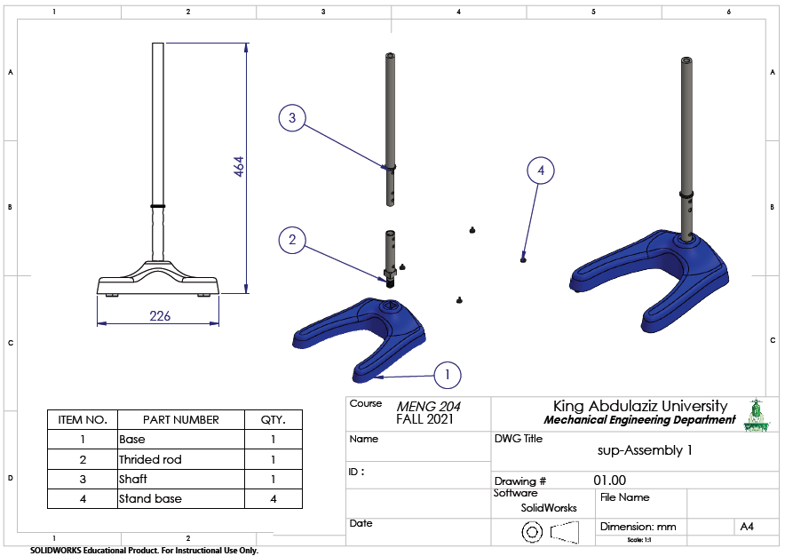

Slide 14
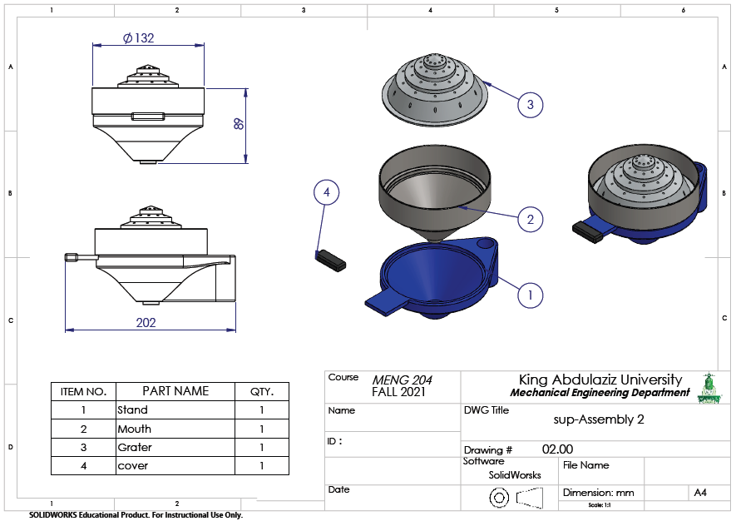

Slide 15
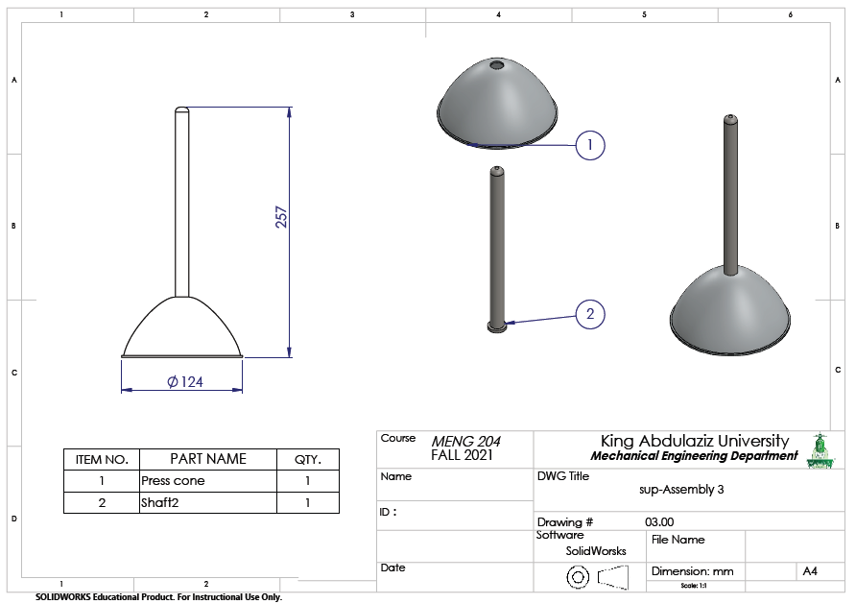

Slide 16
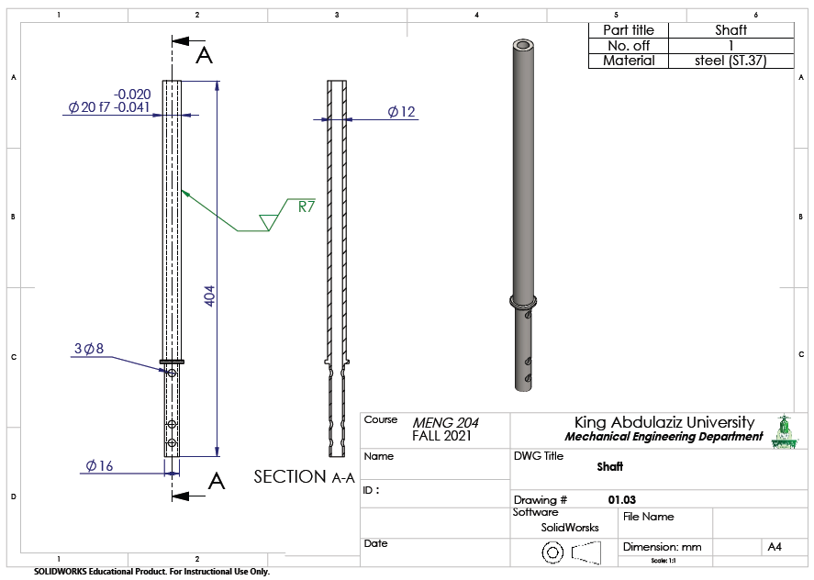

Slide 17
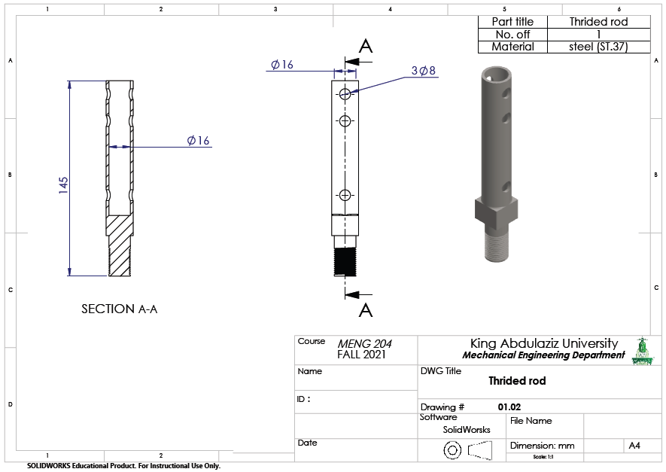

Slide 18
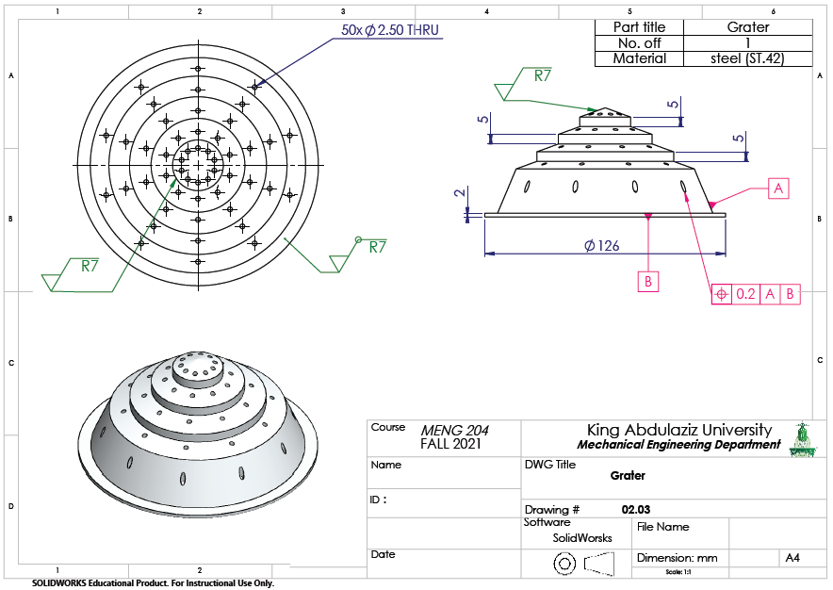

Slide 19
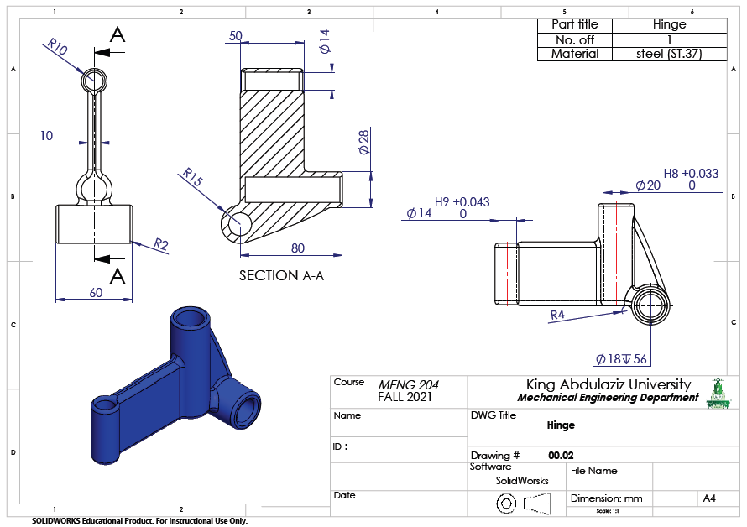

Slide 20
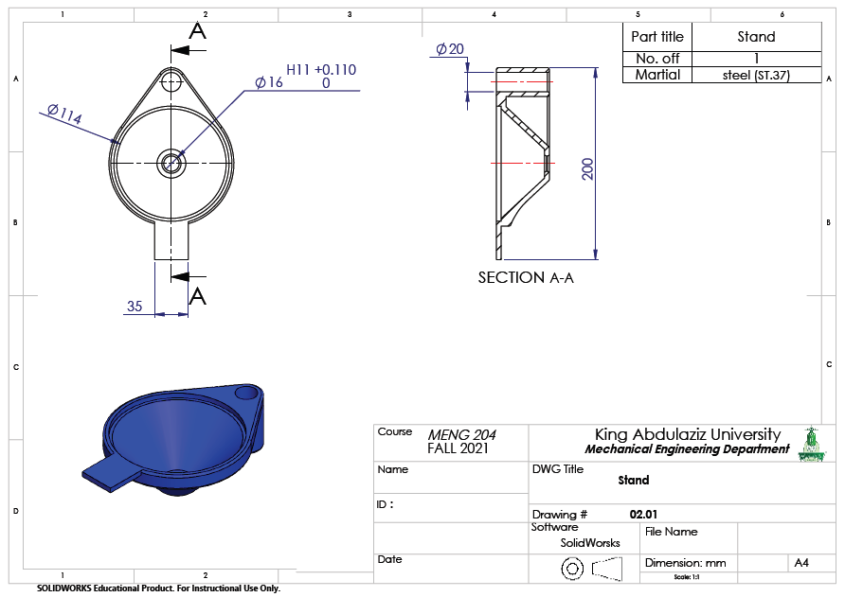

Slide 21
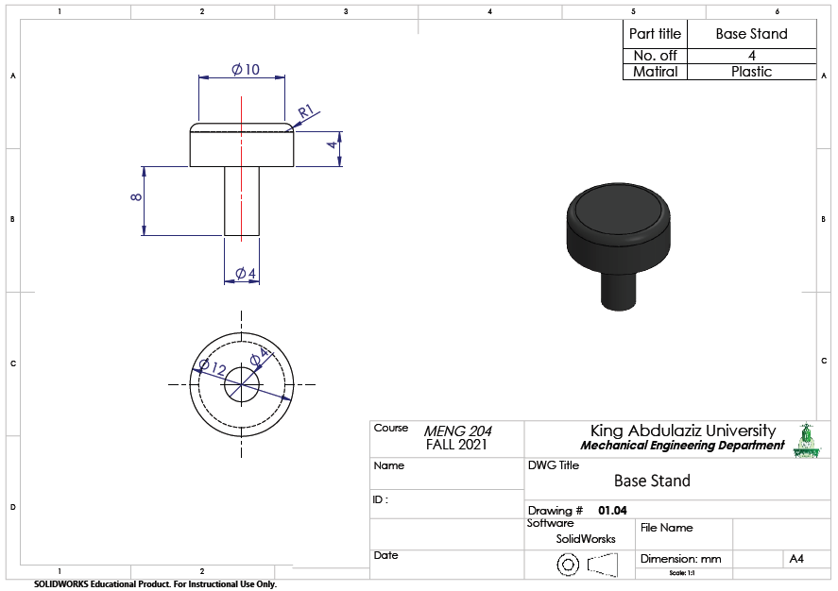

Slide 22
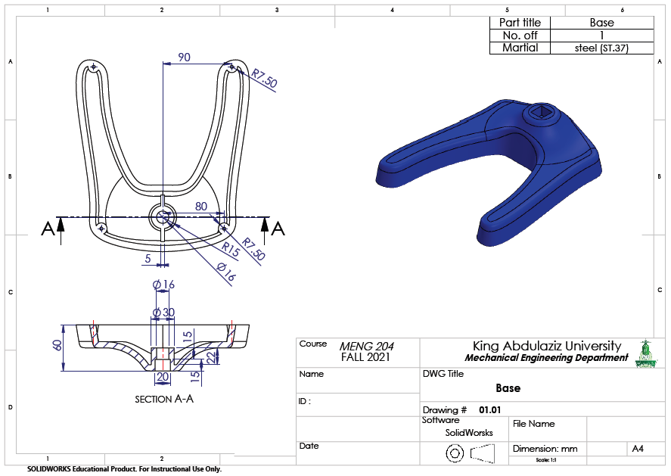

Slide 23
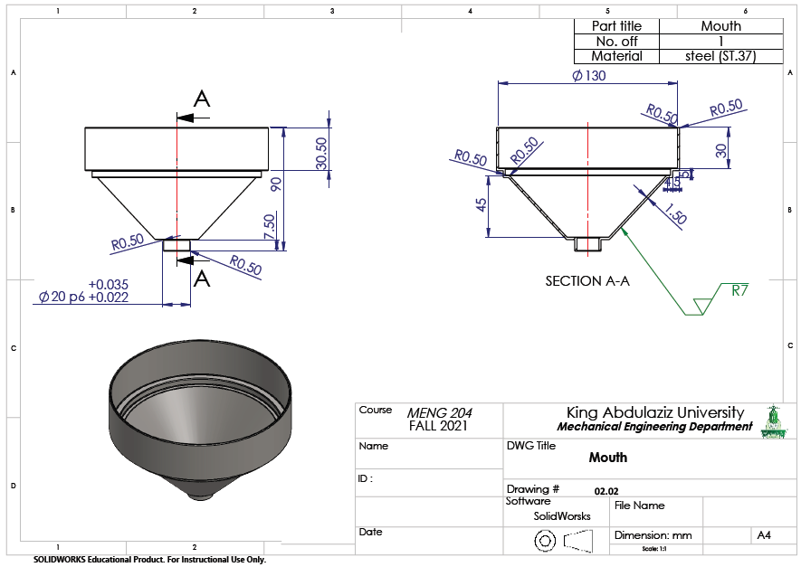

Slide 24
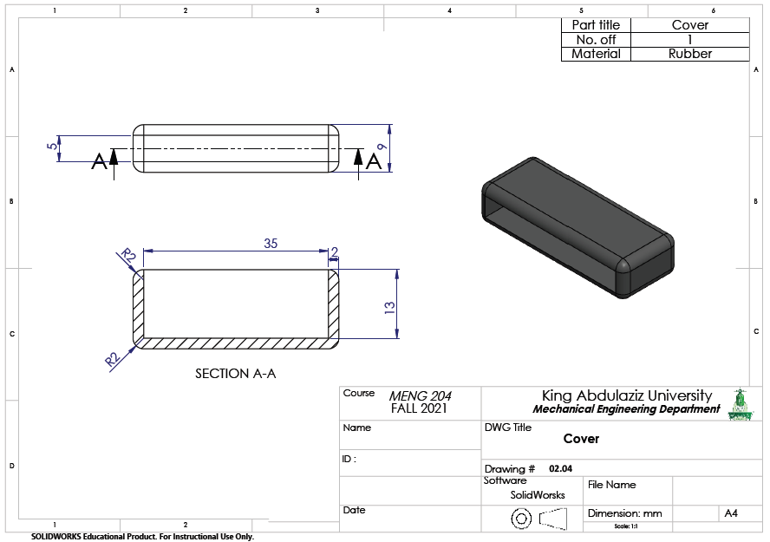

Slide 25
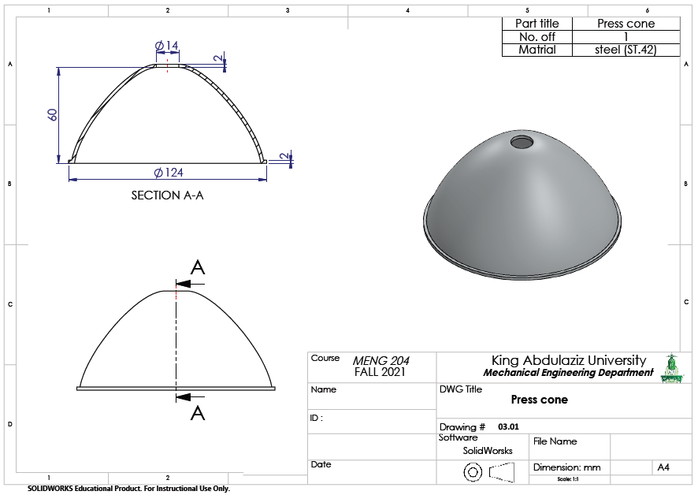

Slide 26
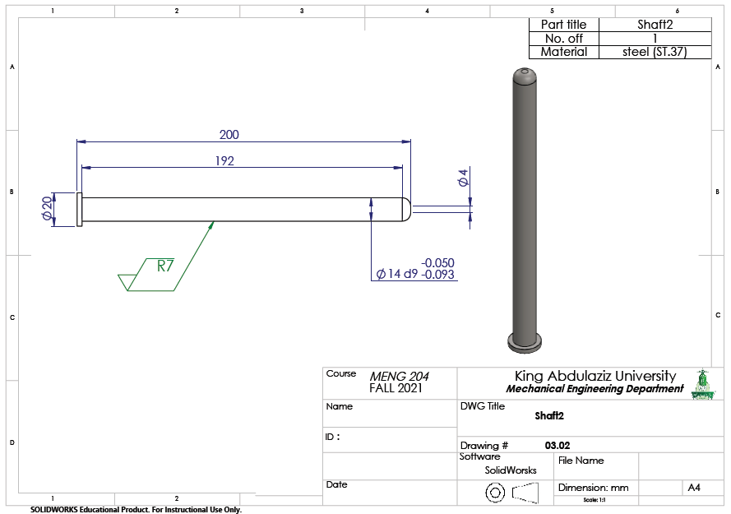

Slide 27
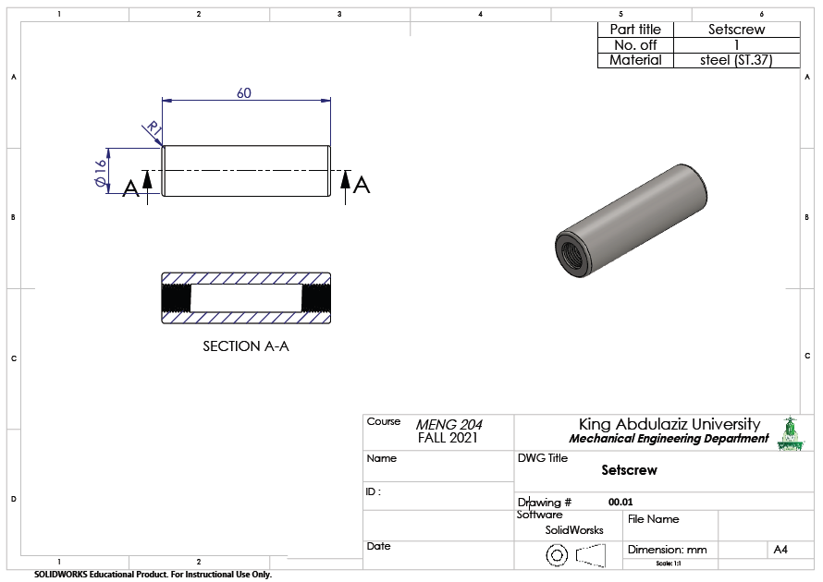

Slide 28
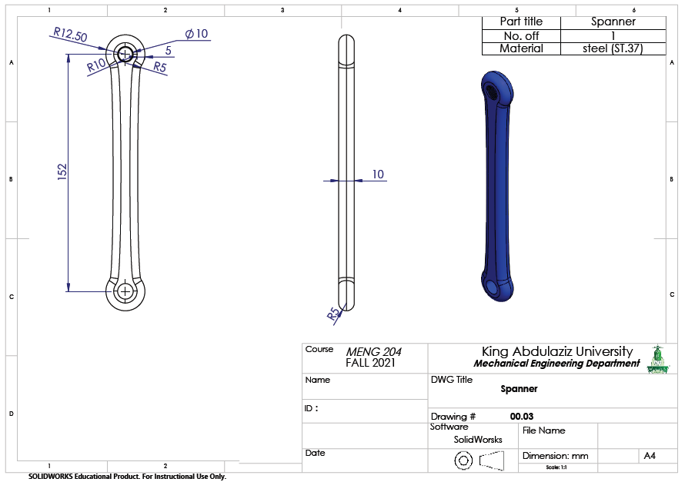

Slide 29
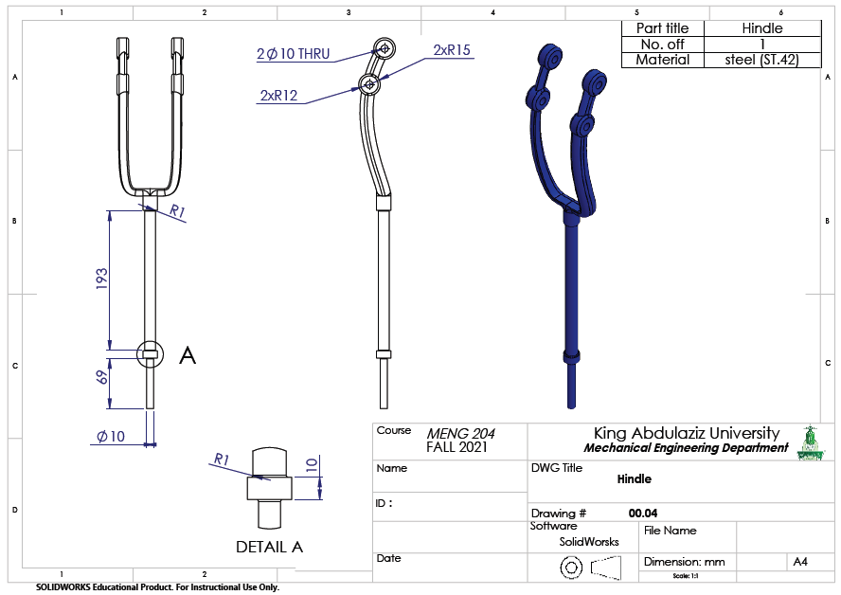

Slide 30
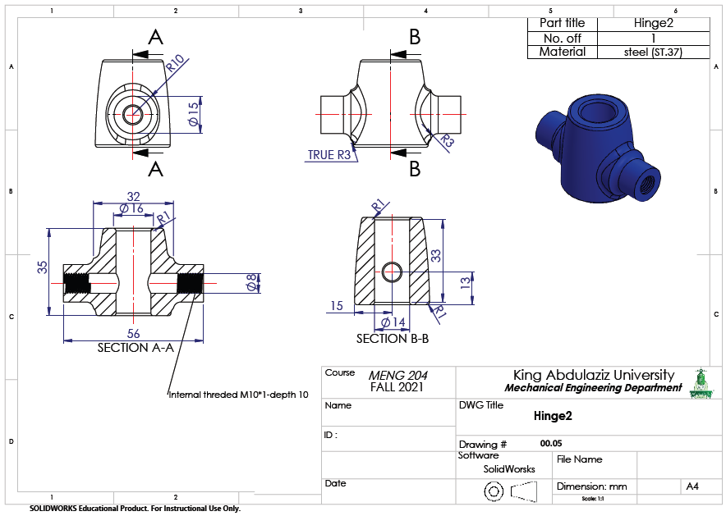

Slide 31
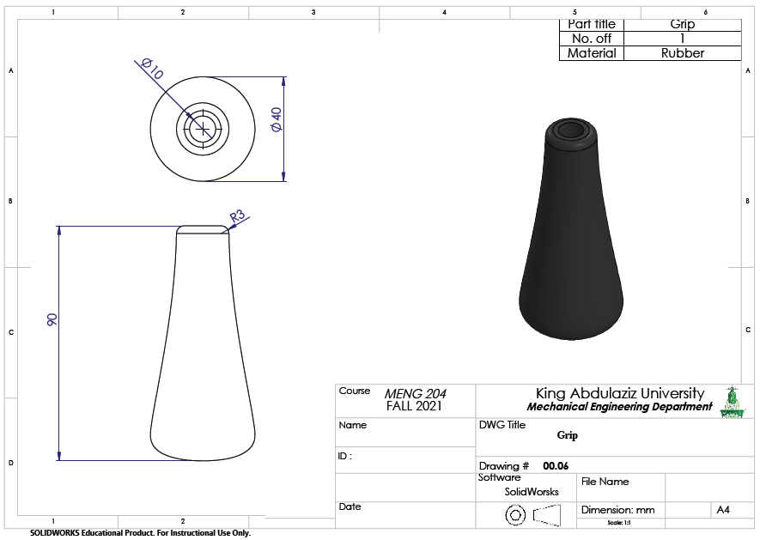

Slide 32
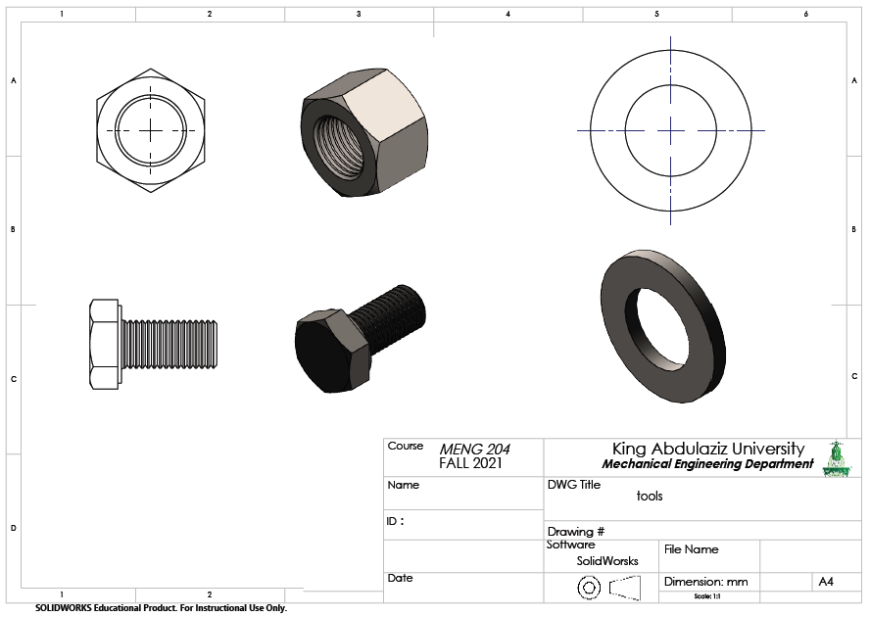

Slide 33
Videos

Slide 34


Slide 35
THANK YOU ALL!

